Slide 1
5. DWBA_fig

Slide 2
Coordinate System (Stripping)
x
r =r
r =r
bx
2
Ax
1
a
B
r
r
a
b
b
r
A
Projectile
Target
Figure 1

Slide 3
Coordinate System (Pick-up)
x
r =r
r =r
ax
2
Bx
1
b
r
r
A
b
a
a
r
B
Projectile
Target
Figure 2

Slide 4
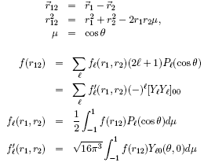
Multipole Expansion of Scalar Function
r
12
r
1
r
2
Figure 3

Slide 5
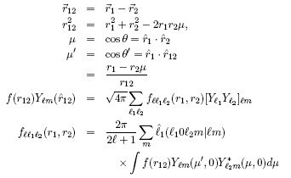
Multipole Expansion of Vector Function
Z-axis
r
12
r
1
r
2
Figure 4

